Slide 1
Code Styling
A brief rundown

Slide 2
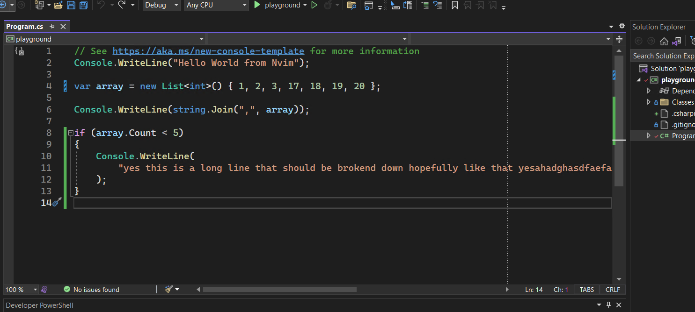
Line width

Slide 3
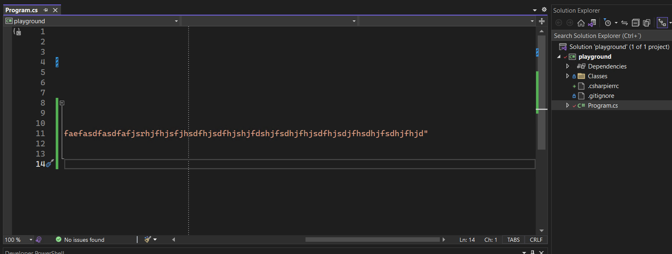
Line width

Slide 4

var people = new List<Person>
{
new() { Name = "John", Type = "Caucasian", Age = 21},
};

Slide 5

var people = new List<Person>
{
new() { Name = "John", Type = "Caucasian", Age = 21 },
};

Slide 6

var people = new List<Person>
{
new()
{
Name = "John",
Type = "Caucasian",
Age = 21
},
};

Slide 7

var people = new List<Person>
{
new() { Name = "John", Type = "Caucasian", Age = 21},
};

Slide 8
people
// .AsNoTracking()
.OrderBy(p => p.Name).Where(p => p.Type == "Hello" && p.Age > 20 || (p.Name == "Diego" || string.IsNullOrEmpty(p.Address))).OrderByDescending(p => p.CurrentTask);

Slide 9
people
// .AsNoTracking()
.OrderBy(p => p.Name)
.Where(p => p.Type == "Hello" && p.Age > 20 ||
(p.Name == "Diego" || string.IsNullOrEmpty(p.Address)))
.OrderByDescending(p => p.CurrentTask)
.Select(x => new
{
x.Address,
x.CurrentTask,
Hobbies = x.Hobbies
.Where(x => x.True)
.ToList(),
});

Slide 10
people
// .AsNoTracking()
.OrderBy(p => p.Name)
.Where(
p =>
p.Type == "Hello" && p.Age > 20
|| (p.Name == "Diego" || string.IsNullOrEmpty(p.Address))
)
.OrderByDescending(p => p.CurrentTask)
.Select(
x =>
new
{
x.Address,
x.CurrentTask,
Hobbies = x.Hobbies.Where(x => x.True).ToList(),
}
);

Slide 11
people
// .AsNoTracking()
.OrderBy(p => p.Name).Where(p => p.Type == "Hello" && p.Age > 20 || (p.Name == "Diego" || string.IsNullOrEmpty(p.Address))).OrderByDescending(p => p.CurrentTask);

Slide 12
DiegoB
people
// .AsNoTracking()
.OrderBy(p => p.Name)
.Where(p =>
p.Type == "Hello" && p.Age > 20 ||
(p.Name == "Diego" ||
string.IsNullOrEmpty(p.Address) && true))
.OrderByDescending(p => p.CurrentTask)
.Select(x => new
{
x.Address,
x.CurrentTask,
Hobbies = x.Hobbies
.Where(x => x.True)
.ToList(),
});

Slide 13
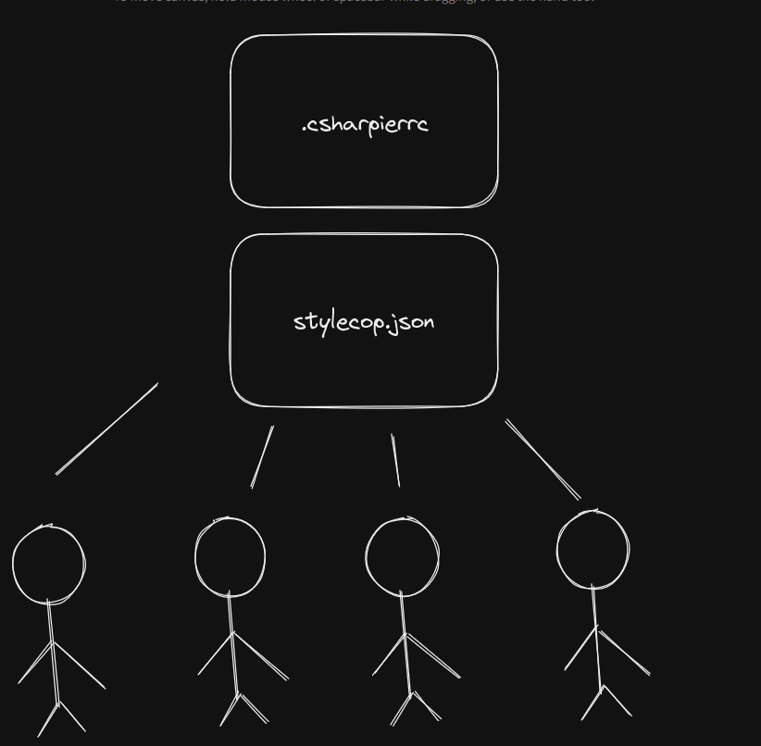
Config files

Slide 14

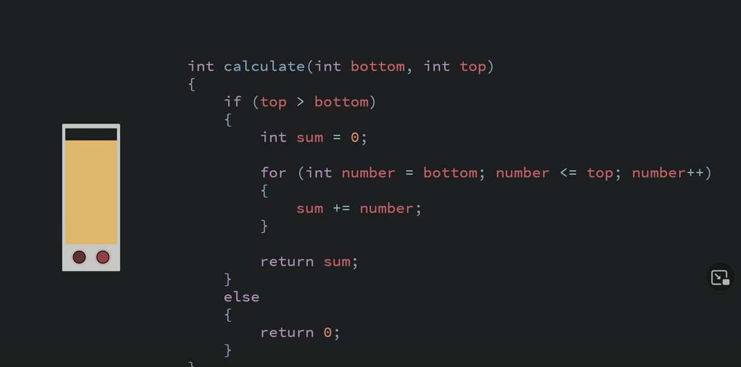
Code Aesthetic

Slide 15
References
CSharpier. (n.d.). Retrieved February 27, 2023, from https://csharpier.com/docs/Configuration
DotNetAnalyzers. (n.d.). StyleCopAnalyzers/documentation at master · DotNetAnalyzers/stylecopanalyzers. GitHub. Retrieved February 27, 2023, from https://github.com/DotNetAnalyzers/StyleCopAnalyzers/tree/master/documentation
Pissarra, R. (2022, October 12). Object calisthenics: Principles for better object-oriented code. Object Calisthenics. Retrieved February 27, 2023, from https://blog.avenuecode.com/object-calisthenics-principles-for-better-object-oriented-code
Rossum , G. van, Warsaw , B., & Coghlan, N. (n.d.). Python enhancement proposals. PEP 8 – Style Guide for Python Code. Retrieved February 27, 2023, from https://peps.python.org/pep-0008/
Code Aesthetic. (2022). Why you shouldn't nest your code. Retrieved February 28, 2023, from https://www.youtube.com/watch?v=CFRhGnuXG-4&t=1s.

Slide 16
References
KevinKevin 3, Reed CopseyReed Copsey 549k7878 gold badges11481148 silver badges13671367 bronze badges, AaronaughtAaronaught 120k2525 gold badges262262 silver badges340340 bronze badges, PermaquidPermaquid 1, Kaleb BraseeKaleb Brasee 50.9k88 gold badges108108 silver badges113113 bronze badges, Diego TerceroDiego Tercero 1, & Kris KrauseKris Krause 7. (1956, December 1). C# coding style - line length / wrapping lines. Stack Overflow. Retrieved February 28, 2023, from https://stackoverflow.com/questions/2151836/c-sharp-coding-style-line-length-wrapping-lines
Conway, D. (n.d.). Perl best practices. O'Reilly.
Seemann, M. (n.d.). The 80/24 rule. Retrieved February 28, 2023, from https://blog.ploeh.dk/2019/11/04/the-80-24-rule/

